Slide 1
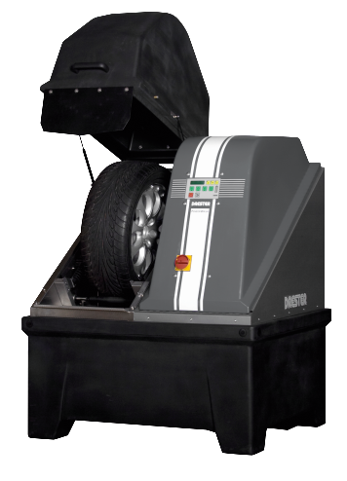
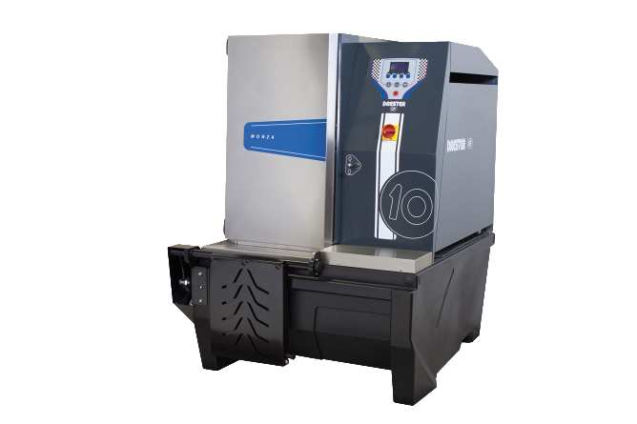
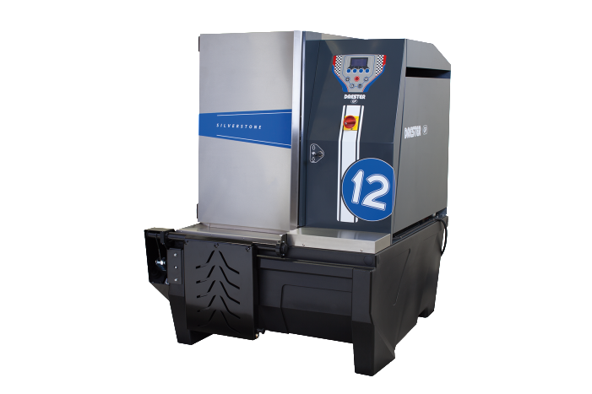
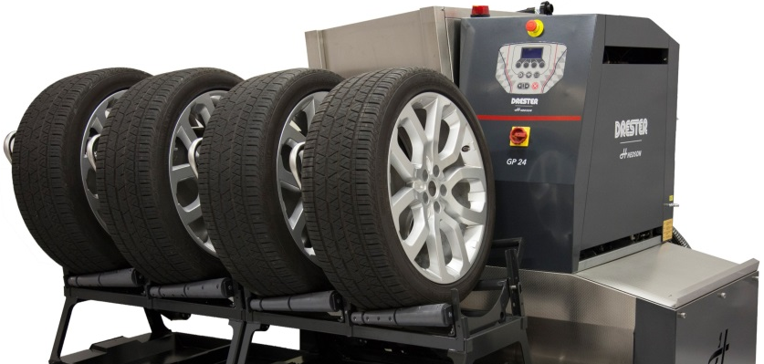
ROI Calculations – Pay back time
W-450 Powerwash
Pay back time: 16 months
250 cars/season
Washing 2000 wheels/year.
Standard machine price € 6 390,-
€ 2,5,- charged cleaning cost /wheel
GP10 Monza
Pay back time: 10 months
500 cars/season
Washing 4000 wheels/year.
Standard machine price € 7 990,-
€ 2,5,- charged cleaning cost /wheel
GP12 Silverstone
Pay back time: 13 months
500 cars/season
Washing 4000 wheels/year.
Standard machine price € 10090,-
€ 2,5,- charged cleaning cost /wheel
GP24 Le Mans
Pay back time: 14 months
1 000 cars/season
Reduced manpower cleaning wheels ~500h
( ~€ 10 000)
Washing 8000 wheels/year.
Standard machine price € 23000,-
€ 2,5,- charged cleaning cost /wheel

Slide 2
Pay back time – Drester GP24 Le Mans by Hedson
Price/wheel | Wheels/year
€ | 6 000 | 8 000 | 10 000 | 12 000
€ 2 | 1 year, 11 months | 1 year, 6 months | 1 year, 2 months | 1 year
€ 2,5 | 1 year, 7 months | 1 year, 2 months | 1 year | 10 months
€ 3 | 1 year, 4 months | 1 year | 10 months | 8 months
*Based on the standard price € 23 000,-

